Slide 1
Java Arrays
Arrays are used to store multiple values in a single variable, instead of declaring separate variables for each value.
To declare an array, define the variable type with square brackets:
Example:
String[] cars;

Slide 2
We have now declared a variable that holds an array of strings. To insert values to it, we can use an array literal - place the values in a comma-separated list, inside curly braces:
String[] cars = {"Volvo", "BMW", "Ford", "Mazda"};
To create an array of integers, you could write:
int[] myNum = {10, 20, 30, 40};

Slide 3
Access the Elements of an Array
You access an array element by referring to the index number.
This statement accesses the value of the first element in cars:
Example
String[] cars = {"Volvo", "BMW", "Ford", "Mazda"};
System.out.println(cars[0]);
// Outputs Volvo
Note: Array indexes start with 0: [0] is the first element. [1] is the second element, etc.

Slide 4
Change an Array Element
To change the value of a specific element, refer to the index number:
Example
cars[0] = "Opel";
Example
String[] cars = {"Volvo", "BMW", "Ford", "Mazda"};
cars[0] = "Opel";
System.out.println(cars[0]);
// Now outputs Opel instead of Volvo

Slide 5
Loop Through an Array
You can loop through the array elements with the for loop, and use the length property to specify how many times the loop should run.
The following example outputs all elements in the cars array:
Example
String[] cars = {"Volvo", "BMW", "Ford", "Mazda"};
for (int i = 0; i < cars.length; i++) {
System.out.println(cars[i]);
}

Slide 6
Multidimensional Arrays
A multidimensional array is an array containing one or more arrays.
To create a two-dimensional array, add each array within its own set of curly braces:
Example
int[][] myNumbers = { {1, 2, 3, 4}, {5, 6, 7} };
myNumbers is now an array with two arrays as its elements.To access the elements of the myNumbers array, specify two indexes: one for the array, and one for the element inside that array. This example accesses the third element (2) in the second array (1) of myNumbers:
Example
int[][] myNumbers = { {1, 2, 3, 4}, {5, 6, 7} };
int x = myNumbers[1][2];
System.out.println(x); // Outputs 7

Slide 7
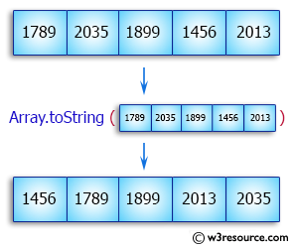
Array practice questions
1. Write a Java program to sort a numeric array and a string array.

Slide 8
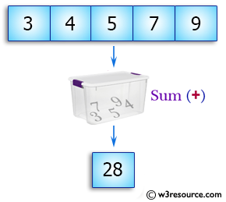
2. Write a Java program to sum values of an array.

Slide 9
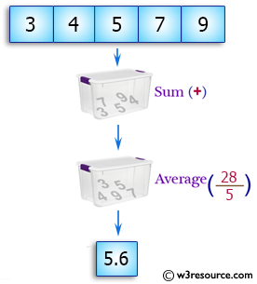
3. Write a Java program to calculate the average value of array elements.

Slide 10
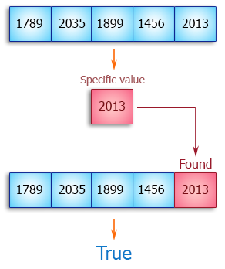
Write a Java program to test if an array contains a specific value.

